Slide 1

Sistem Prediksi Kepribadian
Big Five Personality Berdasarkan
Data Pengguna Facebook
Tommy Tandera - 1701351231
Hendro - 1701317080

Slide 2
Latar Belakang
1

Slide 3
Personality is the complex of all the attributes—behavioural, temperamental, emotional and mental—that characterise a unique individual.
- Mairesse et al., 2007
Personality Recognition is a computational task that consists
in the automatic classification of authors’ personality traits
from pieces of text they wrote. (Celli, 2013)

Slide 4





Personality Prediction
Based on Big Five Personality
Conscientiousness
Agreeableness
Openness
Extraversion
Neuroticism

Slide 5
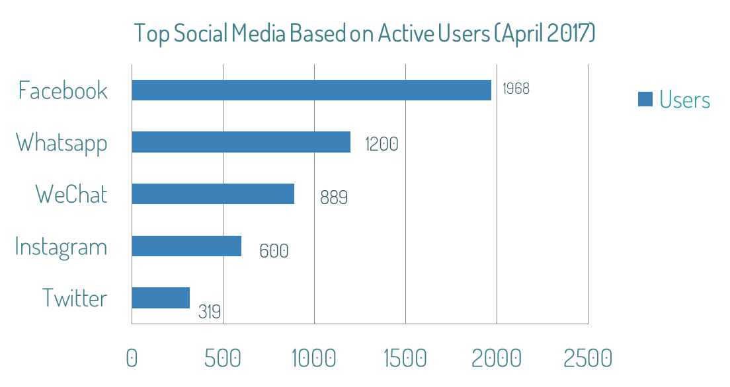
Social Media Usage
Source: statista.com

Slide 6
Metodologi
2

Slide 7
Distribusi Dataset Penelitian
Dataset myPersonality (250 users)
 | Openness | Conscientiousness | Extraversion | Agreeableness | Neuroticism
Yes | 176 | 130 | 96 | 134 | 99
No | 74 | 120 | 154 | 116 | 151
Dataset manual gathering (150 users)
 | Openness | Conscientiousness | Extraversion | Agreeableness | Neuroticism
Yes | 97 | 63 | 38 | 81 | 50
No | 53 | 87 | 112 | 69 | 100

Slide 8
Distribusi Dataset Penelitian
Dataset Combine (400 users)
 | Openness | Conscientiousness | Extraversion | Agreeableness | Neuroticism
Yes | 273 | 193 | 134 | 215 | 149
No | 127 | 207 | 266 | 185 | 251

Slide 9
Dataset
Dataset myPersonality
Auth ID | Status | cEXT | cNEU | cAGR | cCON | cOPN | DATE
b7b7764cfa1c523e4e93ab2a79a946c4 | likes the sound of thunder… | n | y | n | n | y | 6/19/2009 15:21
318bf822d4f2bd3920367560218619c0 | has bed bugs..... ewwwww!... | y | y | n | y | n | 6/27/2009 23:21
ecbddbfe00e0f83cfdb802a7186061c7 | is stuck on Band-Aid brand, cuz Band-Aid's stuck on me!... | y | n | y | n | y | 6/28/2009 5:03

Slide 10
Dataset
Dataset Manual Gathering
User ID | Status | cEXT | cNEU | cAGR | cCON | cOPN | DATE
10208496777609200 | I think it's going to run out of 20-30s theme bb… | n | n | n | n | n | 05/19/2017 08:29
1558335764186290 | Like, in TS Puri, 160, Make your own jersey, Wow, my boot… | y | n | n | y | n | 05/19/2017 08:39
10207297499594200 | Merry Christmas everyone! , The Cross before me… | y | y | n | y | n | 05/19/2017 08:39

Slide 11
PROCESS
Word Preprocessing
Building Model
& Classification
Model Testing
& Evaluation

Slide 12
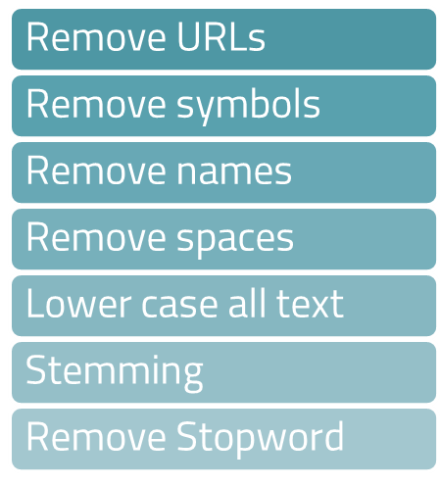
Word Preprocessing

Slide 13
Word Preprocessing
WOW!!! I just spent 20 minutes reading just this one strip with *PROPNAME* and Andre Wijaya ©... http:////xkcd.com//657//
Stemming (spend)
Remove Spaces
Remove Stopwords
Lower case
Remove Names
Remove URLs
Remove Symbols
Result:
wow!!! spend 20 minute read one strip ...

Slide 14
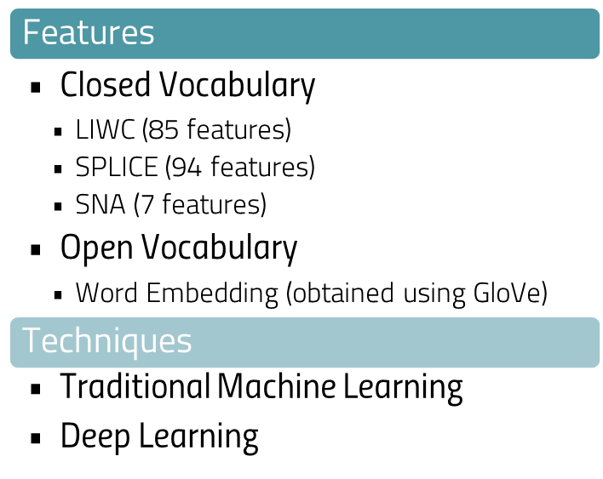
Building Model

Slide 15
Machine Learning Classifiers
Deep Learning
Architectures
Naïve
Bayes
MLP
CNN 1D
SVM
LDA
LSTM
GRU
Logistic
Regression
Gradient
Boosting

Slide 16
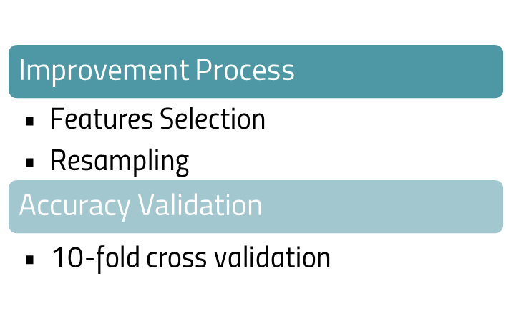
Model Testing & Classification

Slide 17
Improvement Process
Features Selection
Penghilangan fitur-fitur yang dianggap menjadi noise atau memiliki korelasi rendah terhadap traits kepribadian. Perhitungan Features Selection menggunakan metode chi-square.
Resampling
Penyeimbangan distribusi dataset penelitian. Menggunakan library imbalanced_learn
Undersampling (teknik ClusterCentroids)
Oversampling (teknik SMOTE)

Slide 18
Testing
Scenario
Features | Feature Selection |  | Resampling |  |  | Scenario
 | No | Yes | None | Undersampling | Oversampling
LIWC | ✓ |  | ✓ |  |  | 1
 | ✓ |  |  | ✓ |  | 2
 | ✓ |  |  |  | ✓ | 3
 |  | ✓ | ✓ |  |  | 4
 |  | ✓ |  | ✓ |  | 5
 |  | ✓ |  |  | ✓ | 6
SPLICE | ✓ |  | ✓ |  |  | 7
 | ✓ |  |  | ✓ |  | 8
 | ✓ |  |  |  | ✓ | 9
 |  | ✓ | ✓ |  |  | 10
 |  | ✓ |  | ✓ |  | 11
 |  | ✓ |  |  | ✓ | 12
SNA | ✓ |  | ✓ |  |  | 13
 | ✓ |  |  | ✓ |  | 14
 | ✓ |  |  |  | ✓ | 15
 |  | ✓ | ✓ |  |  | 16
 |  | ✓ |  | ✓ |  | 17
 |  | ✓ |  |  | ✓ | 18

Slide 19
Hasil
3

Slide 20
Traditional Machine Learning Result on myPersonality Dataset
(1) = 6
(3) = 1
(4) = 7
(5) = 2
(6) = 1
(7) = 1
(8) = 1
(12) = 1
(13) = 1
(14) = 1
(16) = 3
Algoritma | Openness | Conscientiousness | Extraversion | Agreeableness | Neuroticism | Average
Naïve Bayes | 70.00 (4) | 59.20 (14) | 68.80 (1) | 56.40 (8) | 54.40 (1) | 61.76
SVM | 70.40 (4) | 56.00 (4) | 61.60 (4) | 56.80 (12) | 60.40 (4) | 61.04
Logistic Regression | 70.40 (1) | 54.40 (3) | 68.40 (1) | 53.60 (5) | 60.40 (4) | 61.44
Gradient Boosting | 63.20 (1) | 56.40 (5) | 68.00 (13) | 63.20 (6) | 59.20 (16) | 62.00
LDA | 70.00 (16) | 58.40 (14) | 68.00 (16) | 58.00 (7) | 60.80 (1) | 63.04
Average | 68.80 | 56.88 | 66.96 | 57.60 | 59.04

Slide 21
Traditional Machine Learning Result on Manual Gathering Dataset
(1) = 12
(2) = 1
(3) = 1
(4) = 6
(5) = 1
(6) = 1
(7) = 1
(11) = 1
(12) = 1
Algoritma | Openness | Conscientiousness | Extraversion | Agreeableness | Neuroticism | Average
Naïve Bayes | 60.67 (1) | 62.67 (1) | 73.33 (1) | 53.33 (2) | 70.00 (4) | 64.00
SVM | 64.67 (4) | 65.33 (1) | 76.00 (1) | 60.67 (12) | 69.33 (1) | 67.20
Logistic Regression | 65.33 (7) | 66.67 (11) | 74.67 (4) | 59.33 (5) | 66.67 (1) | 66.53
Gradient Boosting | 67.33 (1) | 62.67 (1) | 76.00 (4) | 58.67 (6) | 66.67 (1) | 66.26
LDA | 60.00 (4) | 67.33 (1) | 79.33 (1) | 60.67 (3) | 66.67 (4) | 66.80
Average | 63.60 | 64.93 | 75.87 | 58.53 | 67.87

Slide 22
Traditional Machine Learning Result on Combine Dataset
(1) = 11
(2) = 5
(3) = 2
(4) = 8
(10) = 1
Algoritma | Openness | Conscientiousness | Extraversion | Agreeableness | Neuroticism | Average
Naïve Bayes | 65.50 (4) | 55.50 (4) | 63.50 (4) | 54.25 (2) | 57.00 (4) | 59.15
SVM | 68.00 (4) | 60.75 (3) | 66.50 (1) | 54.50 (1) | 62.50 (1) | 62.45
Logistic Regression | 68.50 (1) | 58.50 (2) | 66.50 (4) | 53.75 (4) | 63.75 (1) | 62.20
Gradient Boosting | 65.25 (1) | 59.75 (3) | 64.25 (1) | 56.75 (1&2) | 59.75 (1) | 61.15
LDA | 68.00 (4) | 59.50 (2) | 68.50 (1) | 56.00 (1&2) | 65.25 (10) | 63.45
Average | 67.05 | 58.80 | 65.85 | 55.05 | 61.65

Slide 23
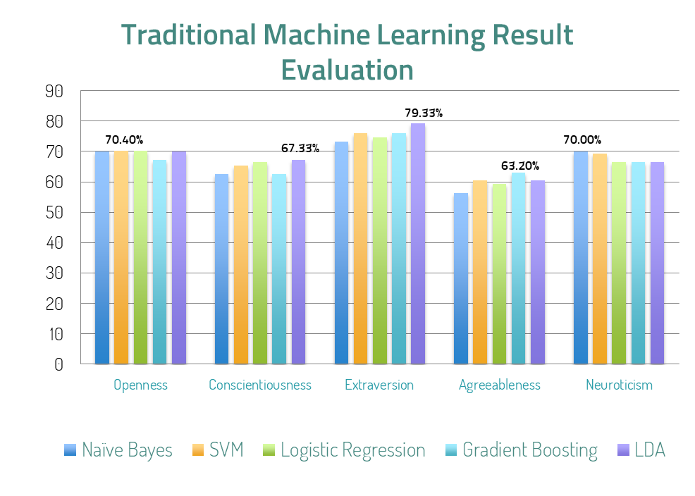
1 Naïve Bayes
SVM
Logistic Regression
Gradient Boosting
LDA

Slide 24
Deep Learning Result on myPersonality Dataset
No Resampling (N) = 7
Undersampling (U) = 12
Oversampling (O) = 6
Arsitektur | Openness | Conscientiousness | Extraversion | Agreeableness | Neuroticism | Average
MLP | 79.31 (U) | 59.62 (O) | 78.95 (U) | 56.52 (U) | 79.49 (U) | 70.78
LSTM | 68.00 (N) | 52.00 (N) | 58.00 (N) | 56.52 (U) | 58.62 (O) | 58.63
GRU | 68.00 (N) | 62.00 (N) | 58.00 (N) | 65.22 (U) | 64.00 (N) | 63.44
CNN 1D | 79.31 (U) | 50.00 (O) | 60.94 (O) | 67.39 (U) | 61.54 (U) | 63.84
LSTM + CNN 1D | 75.86 (U) | 57.69 (O) | 71.05 (U) | 50.00 (O) | 58.97 (U) | 62.71
Average | 74.10 | 56.26 | 65.39 | 59.13 | 64.52

Slide 25
Deep Learning Result on Manual Gathering Dataset
No Resampling (N) = 6
Undersampling (U) = 15
Oversampling (O) = 4
Arsitektur | Openness | Conscientiousness | Extraversion | Agreeableness | Neuroticism | Average
MLP | 66.67 (U) | 64.00 (U) | 93.33 (U) | 70.37 (U) | 75.00 (U) | 73.87
LSTM | 67.50 (O) | 64.00 (U) | 70.00 (N) | 66.67 (U) | 75.00 (U) | 68.63
GRU | 63.33 (N) | 61.76 (O) | 73.33 (U) | 59.38 (O) | 76.67 (N) | 66.89
CNN 1D | 76.19 (U) | 68.00 (U) | 86.67 (U) | 63.33 (N) | 75.00 (U) | 73.84
LSTM + CNN 1D | 67.50 (O) | 66.67 (N) | 93.33 (U) | 63.33 (N) | 80.00 (U) | 74.17
Average | 68.24 | 64.89 | 83.33 | 64.62 | 76.33

Slide 26
Deep Learning Result on Combine Dataset
No Resampling (N) = 12
Undersampling (U) = 11
Oversampling (O) = 3
Arsitektur | Openness | Conscientiousness | Extraversion | Agreeableness | Neuroticism | Average
MLP | 72.00 (U) | 54.55 (U) | 65.00 (N) | 62.16 (U) | 67.80 (U) | 64.30
LSTM | 58.75 (N) | 52.50 (N) | 66.25 (N) | 48.75 (N&O) | 61.25 (N) | 57.50
GRU | 65.00 (N) | 57.61 (O) | 61.25 (N) | 59.46 (U) | 63.75 (N) | 61.41
CNN 1D | 78.00 (U) | 58.75 (N) | 79.25 (U) | 57.50 (N) | 74.58 (U) | 69.61
LSTM + CNN 1D | 72.00 (U) | 54.35 (O) | 77.36 (U) | 55.00 (N) | 71.19 (U) | 65.98
Average | 69.15 | 55.55 | 69.82 | 56.57 | 67.71

Slide 27
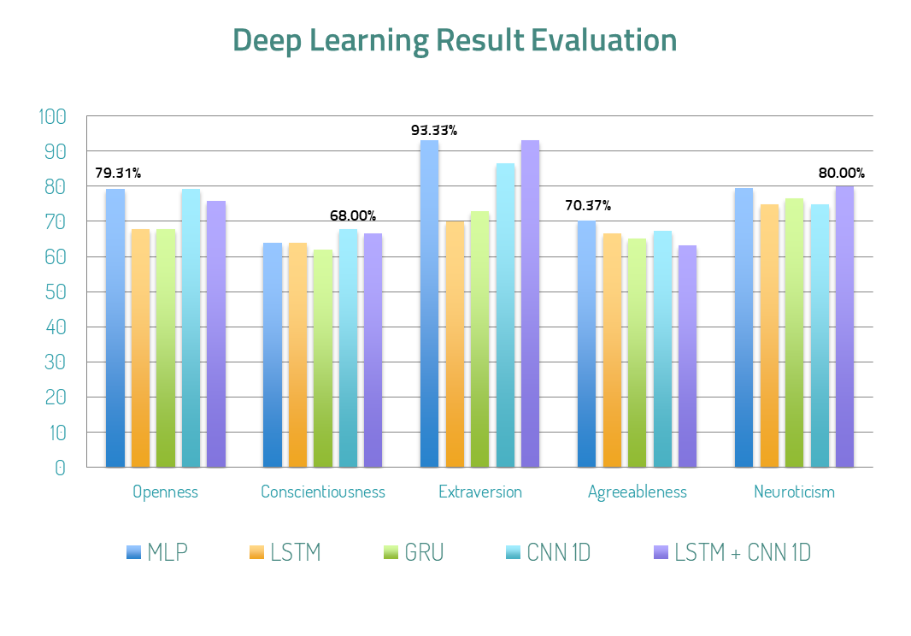
1 Openness
Conscientiousness
Extraversion
Agreeableness
Neuroticism

Slide 28
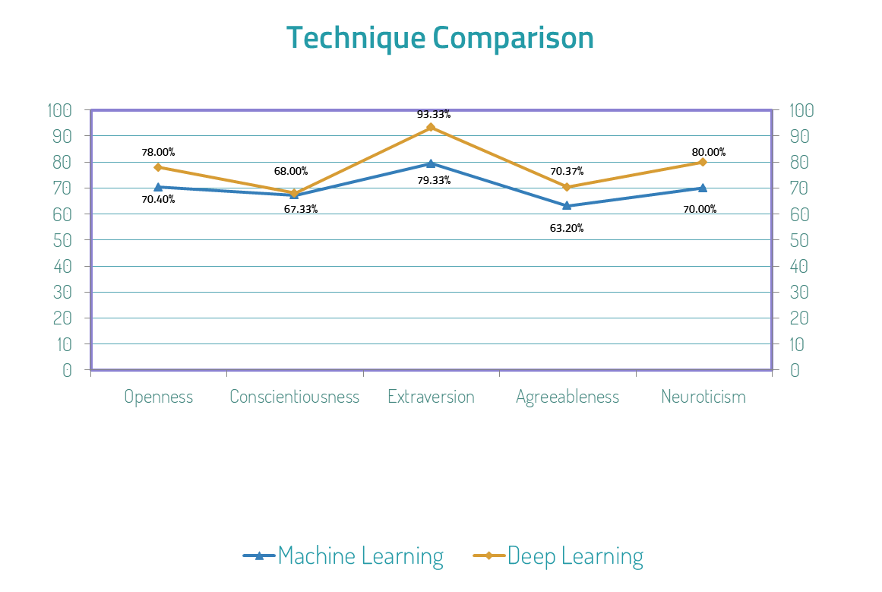

Slide 29
Kesimpulan
4

Slide 30
Kesimpulan
Sistem Prediksi Kepribadian berdasarkan Big Five Personality pada penelitian ini berhasil dibuat dan menunjukkan tingkat akurasi yang cukup baik meskipun dengan dataset yang relatif kecil.
Sistem prediksi penelitian ini menghasilkan akurasi yang lebih tinggi dibandingkan dengan penelitian sebelumnya.
Hasil akurasi tertinggi teknik Deep Learning yaitu 93.33% didapatkan dengan arsitektur MLP dan LSTM+CNN 1D.
Hasil akurasi tertinggi teknik Machine Learning yaitu 79.33% dengan menggunakan Algoritma classifier Linear Discriminant Analysis (LDA).

Slide 31
Kesimpulan
Hasil penelitian menunjukkan teknik Deep Learning dapat meningkatkan hasil akurasi dalam bidang komputasi dan berpotensi untuk dikembangkan lebih lanjut. Hal ini didukung secara langsung oleh hasil akurasi dalam penelitian.
Penambahan Process Improvement Features Selection tidak memberikan peningkatan akurasi sedangkan proses Resampling bekerja cukup baik dalam meningkatkan hasil akurasi sistem prediksi.

Slide 32








Improvement in the Future
More
Datasets

Slide 33




Improvement in the Future
New Techniques
XGBoost
HAN Architecture

Slide 34
THANKS!
Sistem Prediksi Kepribadian
Big Five Personality Berdasarkan
Data Pengguna Facebook
Tommy Tandera & Hendro

